Slide 1
Lecture -1
Virtual Instrumentation with LabVIEW
LabVIEW terms
Components of a LabVIEW application
LabVIEW programming tools
Creating an application in LabVIEW

Slide 2
LabVIEW Environment
LabVIEW software is a graphical (G) programming environment that uses icons, terminals, and wires rather than text to help you program.
Virtual Instruments (VIs)
LabVIEW programs are called virtual instruments, or VIs, because their appearance and operation imitate physical instruments, such as oscilloscopes and multimeters. LabVIEW contains a comprehensive set of tools for acquiring, analyzing, displaying, and storing data as well as tools to help us troubleshoot the code we write.
When we create a new VI, we see two windows: the front panel window and the block diagram.
Notes:
Estimate completion time: 20 minutes. The exercise is easy, but since it will be the first VI that we actually create, it is good to allow ample time to explore the LabVIEW environment.
Instructions: Build a VI that converts °C to °F. When run, the VI should take an input value (°C), multiply it by 1.8, add 32, and display the result (°F). The front panel should display both the input value and the result. Save the VI as Convert C to F.vi.

Slide 3
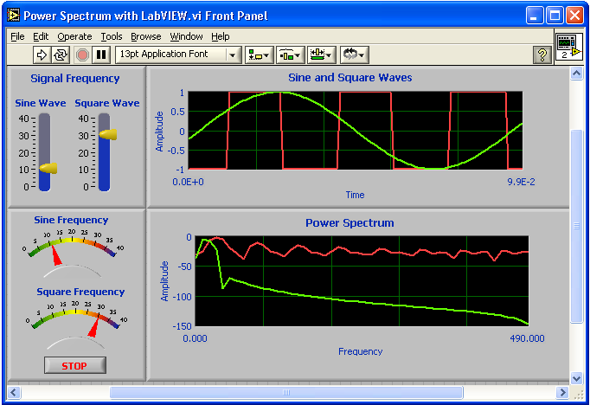
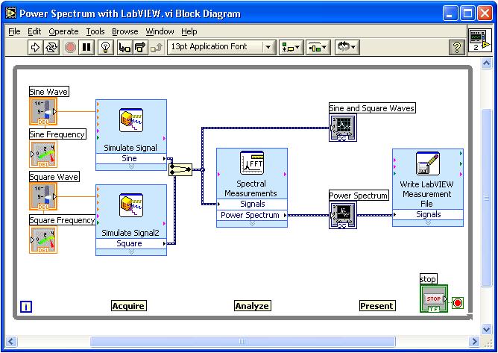
Virtual Instrumentation With LabVIEW
Block Diagram
Front Panel

Slide 4
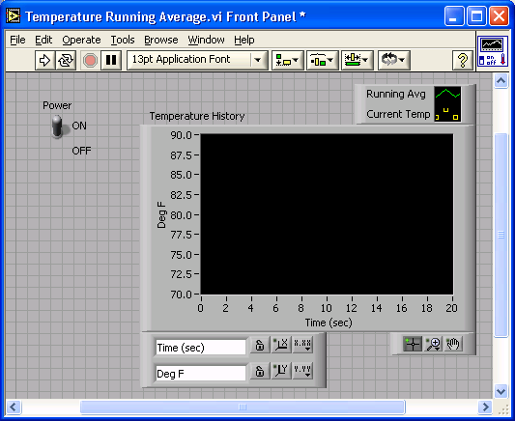
VI Front Panel
Front Panel
Toolbar
Icon
Boolean
Control
Graph
Legend
Waveform
Graph
Plot
Legend
Scale
Legend
Notes:
The front panel is the user interface of the VI. You build the front panel with controls and indicators, which are the interactive input and output terminals of the VI, respectively. Controls are knobs, pushbuttons, dials, and other input devices. Indicators are graphs, LEDs, and other displays. Controls simulate instrument input devices and supply data to the block diagram of the VI. Indicators simulate instrument output devices and display data the block diagram acquires or generates.
In this picture, the Power switch is a boolean control. A boolean contains either a true or false value. The value is false until the switch is pressed. When the switch is pressed, the value becomes true. The temperature history indicator is a waveform graph. It displays multiple numbers. In this case, the graph will plot Deg F versus Time (sec).
The front panel also contains a toolbar, whose functions we will discuss later.

Slide 5
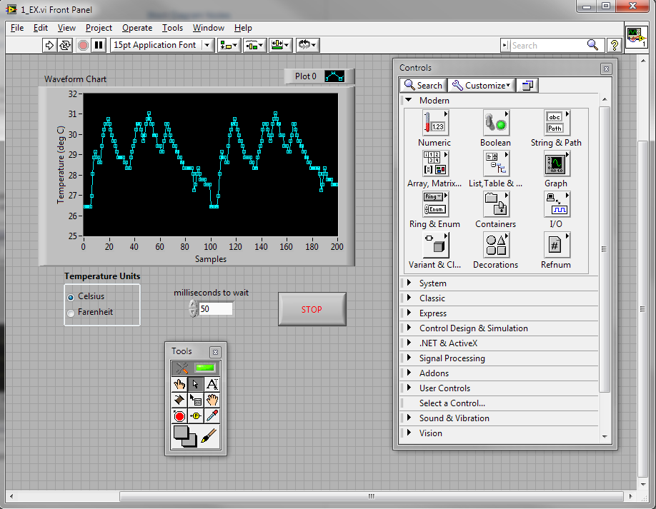
VI Front Panel
Notes:
Estimate completion time: 20 minutes. The exercise is easy, but since it will be the first VI that we actually create, it is good to allow ample time to explore the LabVIEW environment.
Instructions: Build a VI that converts °C to °F. When run, the VI should take an input value (°C), multiply it by 1.8, add 32, and display the result (°F). The front panel should display both the input value and the result. Save the VI as Convert C to F.vi.

Slide 6
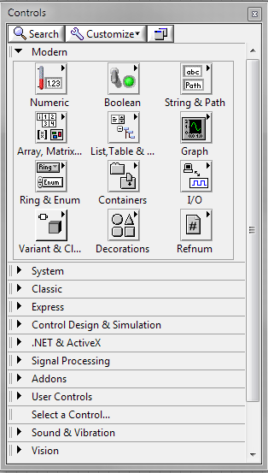
Controls Palette
The Controls palette contains the controls and indicators we use to create the front panel.
We access the Controls palette from the front panel window by by right-clicking on any empty space in the front panel window.
The Controls palette is broken into various categories; Numeric, Boolean, String, etc.
Notes:
Estimate completion time: 20 minutes. The exercise is easy, but since it will be the first VI that we actually create, it is good to allow ample time to explore the LabVIEW environment.
Instructions: Build a VI that converts °C to °F. When run, the VI should take an input value (°C), multiply it by 1.8, add 32, and display the result (°F). The front panel should display both the input value and the result. Save the VI as Convert C to F.vi.

Slide 7
LabVIEW Programs Are Called Virtual Instruments (VIs)
Front Panel
Controls = Inputs
Indicators = Outputs
Block Diagram
Accompanying “program” for front panel
Components “wired” together
Icon/Connector
Means of connecting a VI to other VIs
Notes:
LabVIEW programs are called virtual instruments (VIs).
Stress that controls equal inputs, indicators equal outputs.
Each VI contains three main parts:
Front Panel – How the user interacts with the VI.
Block Diagram – The code that controls the program.
Icon/Connector – Means of connecting a VI to other VIs.
The Front Panel is used to interact with the user when the program is running. Users can control the program, change inputs, and see data updated in real time. Stress that controls are used for inputs- adjusting a slide control to set an alarm value, turning a switch on or off, or stopping a program. Indicators are used as outputs. Thermometers, lights, and other indicators indicate values from the program. These may include data, program states, and other information.
Every front panel control or indicator has a corresponding terminal on the block diagram. When a VI is run, values from controls flow through the block diagram, where they are used in the functions on the diagram, and the results are passed into other functions or indicators.

Slide 8
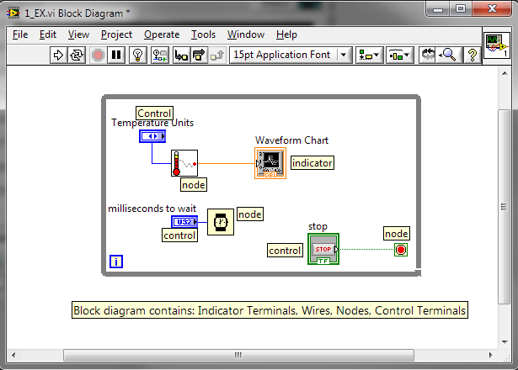
VI Block Diagram
Block diagram objects include terminals, subVIs, functions, constants, structures, and wires, which transfer data among other block diagram objects.
Notes:
Estimate completion time: 20 minutes. The exercise is easy, but since it will be the first VI that we actually create, it is good to allow ample time to explore the LabVIEW environment.
Instructions: Build a VI that converts °C to °F. When run, the VI should take an input value (°C), multiply it by 1.8, add 32, and display the result (°F). The front panel should display both the input value and the result. Save the VI as Convert C to F.vi.

Slide 9
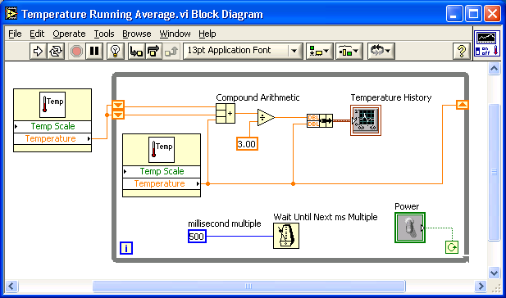
VI Block Diagram
Block Diagram Toolbar
Divide
Function
SubVI
Graph
Terminal
Wire
Data
While Loop
Structure
Numeric
Constant
Timing
Function
Boolean Control Terminal
Notes:
The block diagram contains this graphical source code. Front panel objects appear as terminals on the block diagram. Additionally, the block diagram contains functions and structures from built-in LabVIEW VI libraries. Wires connect each of the nodes on the block diagram, including control and indicator terminals, functions, and structures.
In this block diagram, the subVI Temp calls the subroutine which retrieves a temperature from a Data Acquisition (DAQ) board. This temperature is plotted along with the running average temperature on the waveform graph Temperature History. The Power switch is a boolean control on the Front Panel which will stop execution of the While Loop. The While Loop also contains a Timing Function to control how frequently the loop iterates.

Slide 10
VI Block Diagram
Block Diagram Window
After we create the front panel window, we add code using graphical representations of functions to control the front panel objects. The block diagram window contains this graphical source code.
Notes:
Estimate completion time: 20 minutes. The exercise is easy, but since it will be the first VI that we actually create, it is good to allow ample time to explore the LabVIEW environment.
Instructions: Build a VI that converts °C to °F. When run, the VI should take an input value (°C), multiply it by 1.8, add 32, and display the result (°F). The front panel should display both the input value and the result. Save the VI as Convert C to F.vi.

Slide 11
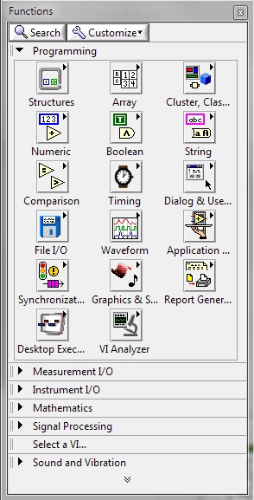
Block Diagram Components
Block Diagram Terminals
Functions Palette
Controls, Indicators, and Constants
Block Diagram Nodes
Functions, SubVIs
Notes:
Estimate completion time: 20 minutes. The exercise is easy, but since it will be the first VI that we actually create, it is good to allow ample time to explore the LabVIEW environment.
Instructions: Build a VI that converts °C to °F. When run, the VI should take an input value (°C), multiply it by 1.8, add 32, and display the result (°F). The front panel should display both the input value and the result. Save the VI as Convert C to F.vi.

Slide 12
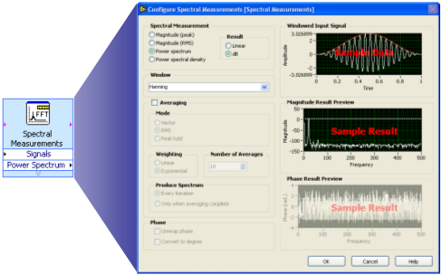
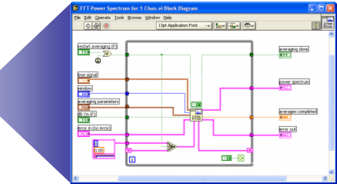
Express VIs, VIs and Functions
Express VIs: interactive VIs with configurable dialog page
Standard VIs: modularized VIs customized by wiring
Functions: fundamental operating elements of LabVIEW; no front panel or block diagram
Function
Express VI
Standard VI
Notes:
LabVIEW 7.0 introduced a new type of subVI called Express VIs. These are interactive VIs that have a configuration dialog box that allows the user to customize the functionality of the Express VI. LabVIEW then generates a subVI based on these settings.
Standard VIs are VIs (consisting of a front panel and a block diagram) that are used within another VI.
Functions are the building blocks of all VIs. Functions do not have a front panel or a block diagram.

Slide 13
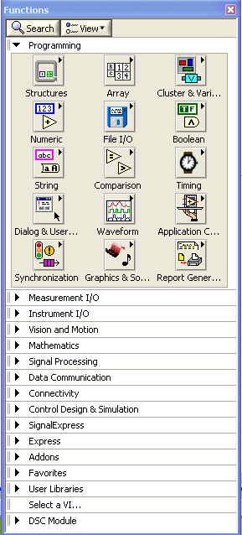
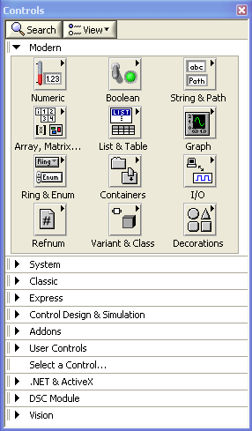
Controls and Functions Palettes
Controls Palette
(Front Panel Window)
Functions Palette
(Block Diagram Window)
Notes:
Use the Controls palette to place controls and indicators on the front panel. The Controls palette is available only on the front panel. Select Window»Show Controls Palette or right-click the front panel workspace to display the Controls palette. You also can display the Controls palette by right-clicking an open area on the front panel. Tack down the Controls palette by clicking the pushpin on the top left corner of the palette.
Use the Functions palette, to build the block diagram. The Functions palette is available only on the block diagram. Select Window»Show Functions Palette or right-click the block diagram workspace to display the Functions palette. You also can display the Functions palette by right-clicking an open area on the block diagram. Tack down the Functions palette by clicking the pushpin on the top left corner of the palette.

Slide 14

Tools Palette
Floating Palette
Used to operate and modify front panel and block diagram objects.
Automatic Selection Tool
Scrolling Tool
Breakpoint Tool
Probe Tool
Color Copy Tool
Coloring Tool
Operating Tool
Positioning/Resizing Tool
Labeling Tool
Wiring Tool
Shortcut Menu Tool
Notes:
If automatic tool selection is enabled and you move the cursor over objects on the front panel or block diagram, LabVIEW automatically selects the corresponding tool from the Tools palette. Toggle automatic tool selection by clicking the Automatic Tool Selection button in the Tools palette.
Use the Operating tool to change the values of a control or select the text within a control.
Use the Positioning tool to select, move, or resize objects. The Positioning tool changes shape when it moves over a corner of a resizable object.
Use the Labeling tool to edit text and create free labels. The Labeling tool changes to a cursor when you create free labels.
Use the Wiring tool to wire objects together on the block diagram.

Slide 15
Status Toolbar
Run Button
Continuous Run Button
Abort Execution
Pause/Continue Button
Text Settings
Align Objects
Distribute Objects
Reorder
Resize front panel objects
Additional Buttons on the Diagram Toolbar
Execution Highlighting Button
Step Into Button
Step Over Button
Step Out Button
Notes:
Click the Run button to run the VI. While the VI runs, the Run button appears with a black arrow if the VI is a top-level VI, meaning it has no callers and therefore is not a subVI.
Click the Continuous Run button to run the VI until you abort or pause it. You also can click the button again to disable continuous running.
While the VI runs, the Abort Execution button appears. Click this button to stop the VI immediately.
Note: Avoid using the Abort Execution button to stop a VI. Either let the VI complete its data flow or design a method to stop the VI programmatically. By doing so, the VI is at a known state. For example, place a button on the front panel that stops the VI when you click it.
Click the Pause button to pause a running VI. When you click the Pause button, LabVIEW highlights on the block diagram the location where you paused execution. Click the Pause button again to continue running the VI.
Select the Text Settings pull-down menu to change the font settings for the VI, including size, style, and color.
Select The Align Objects pull-down menu to align objects along axes, including vertical, top edge, left, and so on.
Select the Distribute Objects pull-down menu to space objects evenly, including gaps, compression, and so on.
Select the Resize Objects pull-down menu to change the width and height of front panel objects.

Slide 16
Creating a VI
Front Panel Window
Block Diagram Window
Control
Terminals
Indicator
Terminals
Notes:
When you create an object on the Front Panel, a terminal will be created on the Block Diagram. These terminals give you access to the Front Panel objects from the Block Diagram code.
Each terminal contains useful information about the Front Panel object it corresponds to. For example, the color and symbols provide the data type. Double-precision, floating point numbers are represented with orange terminals and the letters DBL. Boolean terminals are green with TF lettering.
In general, orange terminals should wire to orange terminals, green to green, and so on. This is not a hard-and-fast rule; LabVIEW will allow a user to connect a blue terminal (integer value) to an orange terminal (fractional value), for example. But in most cases, look for a match in colors.
Controls have an arrow on the right side and have a thick border. Indicators have an arrow on the left and a thin border. Logic rules apply to wiring in LabVIEW: Each wire must have one (but only one) source (or control), and each wire may have multiple destinations (or indicators).
The program in this slide takes data from A and B and passes the values to both an Add function and a subtract function. The results are displayed on the appropriate indicators.

Slide 17
Creating a VI – Block Diagram
Notes:
In addition to Front Panel terminals, the Block diagram contains functions. Each function may have multiple input and output terminals. Wiring to these terminals is an important part of LabVIEW programming.
Once you have some experience programming in LabVIEW, wiring will become easy. At first, you may need some assistance. Here are some tips to get you started:
The wiring tool is used to wire to the nodes of the functions. When you “aim” with the wiring tool, aim with the end of the wire hanging from the spool. This is where the wire will be placed.
As you move the wiring tool over functions, watch for the yellow tip strip. This will tell you the name of the terminal you are wiring to.
As you move the wiring tool over a terminal, it will flash. This will help you identify where the wire will attach.
For more help with the terminals, right-click on the function and select Visible Items>>Terminals. The function’s picture will be pulled back to reveal the connection terminals. Notice the colors- these match the data types used by the front panel terminals.
For additional help, select Help>>Show Context Help, or press CTRL+H. This will bring up the context help window. As you move your mouse over the function, this window will show you the function, terminals, and a brief help description. Use this with the other tools to help you as you wire.

Slide 18

Wiring Tips – Block Diagram
Wiring “Hot Spot”
Click To Select Wires
Use Automatic Wire Routing
Clean Up Wiring
Notes:
In addition to Front Panel terminals, the Block diagram contains functions. Each function may have multiple input and output terminals. Wiring to these terminals is an important part of LabVIEW programming.
Once you have some experience programming in LabVIEW, wiring will become easy. At first, you may need some assistance. Here are some tips to get you started:
The wiring tool is used to wire to the nodes of the functions. When you “aim” with the wiring tool, aim with the end of the wire hanging from the spool. This is where the wire will be placed.
As you move the wiring tool over functions, watch for the yellow tip strip. This will tell you the name of the terminal you are wiring to.
As you move the wiring tool over a terminal, it will flash. This will help you identify where the wire will attach.
For more help with the terminals, right-click on the function and select Visible Items>>Terminals. The function’s picture will be pulled back to reveal the connection terminals. Notice the colors- these match the data types used by the front panel terminals.
For additional help, select Help>>Show Context Help, or press CTRL+H. This will bring up the context help window. As you move your mouse over the function, this window will show you the function, terminals, and a brief help description. Use this with the other tools to help you as you wire.
If your wiring becomes doesn’t look very good, right-click on the particular wire in question and choose Clean Up Wire to automatically re-route that wire.

Slide 19
Dataflow Programming
Block diagram execution is dependent on the flow of data; block diagram does NOT execute left to right
Node executes when data is available to ALL input terminals
Nodes supply data to all output terminals when done
Notes:
LabVIEW follows a dataflow model for running VIs. A block diagram node executes when all its inputs are available. When a node completes execution, it supplies data to its output terminals and passes the output data to the next node in the dataflow path. Visual Basic, C++, JAVA, and most other text-based programming languages follow a control flow model of program execution. In control flow, the sequential order of program elements determines the execution order of a program.
Consider the block diagram above. It adds two numbers and then subtracts 50.0 from the result of the addition. In this case, the block diagram executes from left to right, not because the objects are placed in that order, but because one of the inputs of the Subtract function is not valid until the Add function has finished executing and passed the data to the Subtract function. Remember that a node executes only when data are available at all of its input terminals, and it supplies data to its output terminals only when it finishes execution.
In the code to the right, consider which code segment would execute first—the Add, Random Number, or Divide function. You cannot know because inputs to the Add and Divide functions are available at the same time, and the Random Number function has no inputs. In a situation where one code segment must execute before another, and no data dependency exists between the functions, use a Sequence structure to force the order of execution.

Slide 20
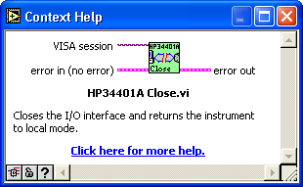
Help Options
Context Help
Online help
Lock help
Simple/Complex Diagram help
Ctrl + H
Online reference
All menus online
Pop up on functions in diagram to access online info directly
Notes:
Use the Context Help window and the LabVIEW Help to help you build and edit VIs. Refer to the LabVIEW Help and manuals for more information.
Context Help Window
To display the Context Help window, select Help»Show Context Help or press the <Ctrl-H> keys. When you move the cursor over front panel and block diagram objects, the Context Help window displays the icon for subVIs, functions, constants, controls, and indicators, with wires attached to each terminal. When you move the cursor over dialog box options, the Context Help window displays descriptions of those options. In the window, required connections are bold, recommended connections are plain text, and optional connections are dimmed or do not appear. Above is an example Context Help window.
Click the Simple/Detailed Context Help button located on the lower left corner of the Context Help window to change between simple and detailed context help. The simple mode emphasizes the important connections. Optional terminals are shown by wire stubs, informing you that other connections exist.
Click the Lock Context Help button to lock the current contents of the Context Help window. When the contents are locked, moving the cursor over another object does not change the contents of the window. To unlock the window, click the button again. You also can access this option from the Help menu.

Slide 21
Exercise 1 - Convert °C to °F
Notes:
Estimate completion time: 20 minutes. The exercise is easy, but since it will be the first VI that we actually create, it is good to allow ample time to explore the LabVIEW environment.
Instructions: Build a VI that converts °C to °F. When run, the VI should take an input value (°C), multiply it by 1.8, add 32, and display the result (°F). The front panel should display both the input value and the result. Save the VI as Convert C to F.vi.

Slide 22

Debugging Techniques
Finding Errors
Execution Highlighting
Probe
Click on broken Run button
Window showing error appears
Click on Execution Highlighting button; data flow is animated using bubbles. Values are
displayed on wires.
Right-click on wire to display probe and it shows data as it flows through wire segment
You can also select Probe tool from Tools palette and click on wire
Notes:
When your VI is not executable, a broken arrow is displayed in the Run button in the palette.
Finding Errors: To list errors, click on the broken arrow. To locate the bad object, click on the error message.
Execution Highlighting: Animates the diagram and traces the flow of the data, allowing you to view intermediate values.
Click on the light bulb on the toolbar.
Probe: Used to view values in arrays and clusters.
Click on wires with the Probe tool or right-click on the wire to set probes.
Breakpoint: Set pauses at different locations on the diagram.
Click on wires or objects with the Breakpoint tool to set breakpoints.
Use Debug Demonstrate VI from BASICS.LLB to demonstrate the options and tools.

Slide 23
Notes:
Estimate completion time: 20 minutes. The exercise is easy, but since it will be the first VI that we actually create, it is good to allow ample time to explore the LabVIEW environment.
Instructions: Build a VI that converts °C to °F. When run, the VI should take an input value (°C), multiply it by 1.8, add 32, and display the result (°F). The front panel should display both the input value and the result. Save the VI as Convert C to F.vi.

Slide 24
Notes:
Estimate completion time: 20 minutes. The exercise is easy, but since it will be the first VI that we actually create, it is good to allow ample time to explore the LabVIEW environment.
Instructions: Build a VI that converts °C to °F. When run, the VI should take an input value (°C), multiply it by 1.8, add 32, and display the result (°F). The front panel should display both the input value and the result. Save the VI as Convert C to F.vi.

Slide 25
Notes:
Estimate completion time: 20 minutes. The exercise is easy, but since it will be the first VI that we actually create, it is good to allow ample time to explore the LabVIEW environment.
Instructions: Build a VI that converts °C to °F. When run, the VI should take an input value (°C), multiply it by 1.8, add 32, and display the result (°F). The front panel should display both the input value and the result. Save the VI as Convert C to F.vi.

Slide 26
Notes:
Estimate completion time: 20 minutes. The exercise is easy, but since it will be the first VI that we actually create, it is good to allow ample time to explore the LabVIEW environment.
Instructions: Build a VI that converts °C to °F. When run, the VI should take an input value (°C), multiply it by 1.8, add 32, and display the result (°F). The front panel should display both the input value and the result. Save the VI as Convert C to F.vi.

